Slide 1


The New York State Dignity Act
TRAINING
PLAINVIEW-OLD BETHPAGE CSD
NOVEMBER 6, 2012
Brought to you by your DASA Steering Committee
Notes:
Before the presentation begins
Distribute the hand-outs
Check projector and sound equipment
Determine the lighting so audience can see the slides and movie clips
Set up room for pair/share or small group sharing (if auditorium use turn and talk)
Leave slide on as participants get settled
Greet participants as they enter the venue
Facilitator introduces him/herself
Say: The New York State Dignity Act requires that every person in a school setting be trained in awareness about bullying prevention and intervention. The law requires that each school building in the state assign a Dignity Act Coordinator.
___________________________ is the Dignity Act Coordinator at our school.
We have a two part presentation for you, presented by Karen Siris, principal of
WS Boardman Elementary School in Oceanside, and a member of the New York State Dignity Act Task Force as the School Administrators’ of New York (SAANYS) representative. There will be some participation from the group and we will pause the film at those times. We will see Part I today and Part II at our next meeting.

Slide 2


Slide 3
POB CARES!
K-Center - COMMUNITY
Old Bethpage Elementary - ACCEPTANCE
Parkway - RESPECT
Pasadena - EDUCATION
Stratford - SENSITIVITY
POBMS, Mattlin, and POBJFKHS – EXAMPLES OF POB CARES IN ACTION

Slide 4
Insert Video HERE

Slide 5

WELCOME
DIGNITY ACT OVERVIEW
WHAT IS BULLYING?
COMMON LANGUAGE
WHERE DO WE GO FROM HERE?

Slide 6
Why Should We Care?
NYS and Change: The Perfect Storm
Bullying takes place in every school every day.
The research is clear that when students feel safe at school, they perform at a higher level.
Notes:
Before this video, the audience is asked to make a personal connection to bullying and harassment. The connection can be through
their own experiences in elementary, middle or high school
the experiences of their own children
the experiences of children in their school setting
Optional…. A turn and talk can take place after viewing the clip, or volunteers may want to share their own stories with the group.

Slide 7
Why have 48 states passed anti-bullying/harassment laws?
(GLSEN, 2010)
39% of students reported that bullying, name calling, and harassment pose a serious problem at school
66% reported that people at school were harassed at least “sometimes” because of their looks or body size
57% reported that students were bullied or harassed “sometimes” because of the way they expressed their gender
No Law in South Dakota and New Mexico

Slide 8
What the kids say….
(Josephson School of Ethics, 2010
43,000 students surveyed)
50% of high school students (2010) admit they bullied someone in the past year
47% admit that they were bullied, teased or taunted in a way that seriously upset them in the past year

Slide 9
CERTAIN GROUPS OF STUDENTS ARE BULLIED MORE OFTEN
71% of students with special needs were bullied at least once a week
LGBT students are twice as likely to admit that they were not planning to complete high school

Slide 10
New York Law
THE LAW
Requires districts and schools to prevent, monitor, and address bullying through: (July, 2012)
Designation of a Dignity Act Coordinator to be trained in non-discriminatory instructional and counseling methods and in handling human relationships
Staff training to raise awareness and sensitivity of school employees to issues of harassment and discrimination
Sensitivity and tolerance curricula for students
Revising the code of conduct to create a school environment free from harassment and discrimination
Reporting of bullying incidents to the state through designated reporting system

Slide 11

New York State Assembly
CYBERBULLYING LAW
SIGNED by Governor Cuomo on July 9, 2012
GOES INTO EFFECT 7/2013
Requires all school staff to report any incident of bullying
AND CYBERBULLYING
to the school principal or superintendent
“Cyberbullying has become a dangerous trend and this legislation gives parents and students the tools needed to overcome it,” said Zebrowski. “Standardized policies and procedures will guide teachers and school staff so that they are better equipped to respond to harassment and bullying within the classroom and beyond.” Assemblyman Kenneth Zebrowski (D- New City, NY)

Slide 12
CYBERBULLYING
(Stomp Out Bullying, 2010)
58% of kids say someone has said mean or hurtful things to them online
53% of kids admit saying something mean or hurtful to another person online

Slide 13
The New York Law: The Dignity Act
The Dignity for All Students Act prohibits harassment with respect to certain non-exclusive protected classes including, but not limited to:
  actual or perceived race
  color
  weight (physical characteristics)
  national origin
  ethnic group
  religion
  religious practice
  disability
  sexual orientation
  perceived sexual orientation
  sex
(N.Y. Educ. Law §§10-18, 801-a)

Slide 14
Dignity Act and
Student Instruction
Requires classroom instruction in:
  Civility
  Citizenship
  Character
  Honesty
  Tolerance
  Personal Responsibility
  Respect for Others
  Dignity for All
Notes:
Say: We have many of these traits and attributes in our curriculum now. We do not have to reinvent the wheel, but we do need to make sure that what we are doing now through literature , social studies, health, character education, assembly programs, are identified as supporting the DIGNITY ACT.
Turn and talk about what comes to mind that is in our curriculum.
Do we need to supplement any aspect of this list?

Slide 15
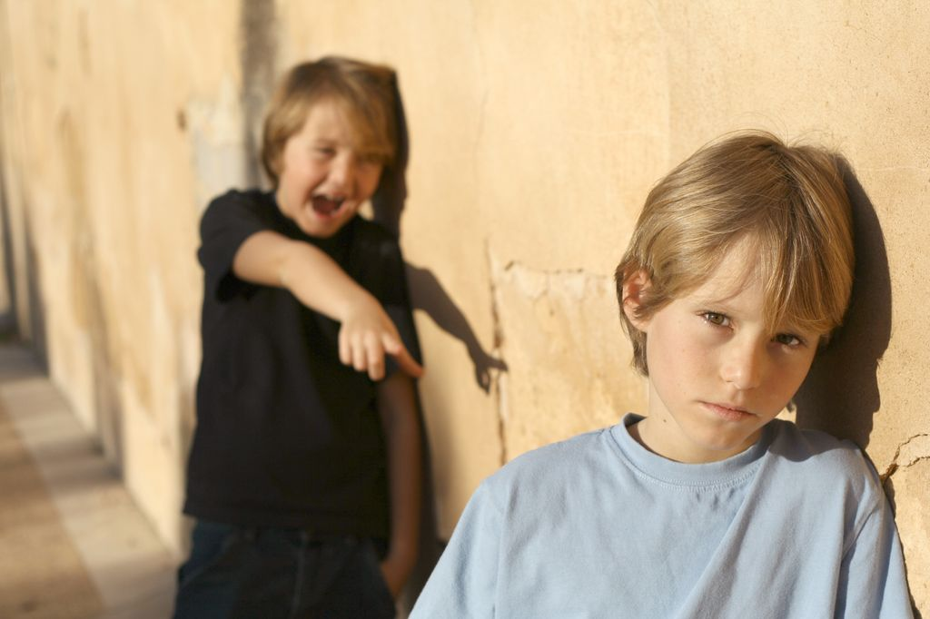
Bullying is a type of harassment
an intentional act of aggression, based on an imbalance of power, that is meant to harm a victim either physically or psychologically.
usually occurs repeatedly and over time, however sometimes can be identified in a single event.

Slide 16
TYPES OF BULLYING BEHAVIORS
PHYSICAL
  Hitting, punching, tripping
  Kicking, pushing, scratching
  Damaging/stealing property
VERBAL
  Name calling, teasing, taunting
  Making offensive remark
  Making discriminatory remarks
  Verbally threatening, intimidating
SOCIAL/EMOTIONAL/RELATIONAL
  Excluding or threatening to exclude
  Spreading rumors, gossiping
  Ostracizing, alienating
  Using threatening looks or gestures
  Extortion
  CYBERBULLYING
  Use of the internet or cell phone to harass and intimidate

Slide 17

The Players – Common Language
THE BULLY
THE TARGET/VICTIM
THE BYSTANDER
THE UPSTANDER

Slide 18

What You Can Do
Implement bullying prevention and intervention strategies that fit your school culture
Implement your district policy that prevents and intervenes in all forms of bullying, cyberbullying and harassment

Slide 19

HOW?
Commit to training all constituents of the school community in prevention and intervention strategies
Establish a Dignity Act Team at the school building level to insure adherence to the district policy

Slide 20

Dignity Act Team
Who: Principal, mental health professionals, school counselors, teachers, non-teaching staff (aides, bus drivers, custodians)
What: Create a bully intervention plan that includes methods for prevention and intervention.

Slide 21

Prevention
Create Positive Climate and Culture
All adults should:
Display warmth, positive interest and involvement
Establish clear rules and implement consistently and with RESPECT
Alert students and other staff members if they are displaying unacceptable behavior toward a student

Slide 22
The Bystanders Hold the Key
“The whole drama is supported by the bystander. The theater can’t take place if there’s no audience.”
(Labi, N. “Let Bullies Beware.”
Time online, March 25, 2001.)

Slide 23

A person who intervenes when s/he witnesses intolerance; someone who makes a stand against bullying
Upstander

Slide 24
Turning Bystanders into Upstanders
Help the students understand the power they have to make a difference – that THEY are the solution
Help students understand the dynamics of bullying situations – 80% of students stand by and watch
Train interested students in teaching the strategies of upstanding behaviors

Slide 25
Turning Bystanders into Upstanders
Insure that bystanders understand that adults will support their actions
Teach all children about the reporting system that is in place in your school
Reward “upstanding” behaviors and make them the norm

Slide 26
Adults Can and Do Make A Difference
The research shows that in schools where bullying is not an issue, EVERY child has at least one adult in the school that they feel comfortable talking to.
Work to be that one person!
POB CARES!!!

Slide 27
Thank-you for your attention and help in ending bullying and harassment in our schools.

